Slide 1

Loan Data and Project Progression
Brandon Rank
MI-462

Slide 2
Agenda
01
Project Data
02
Data Analytics Process
03
Visualizations
04
Future Considerations & Conclusion

Slide 3
Data Set Chosen
01

Slide 4
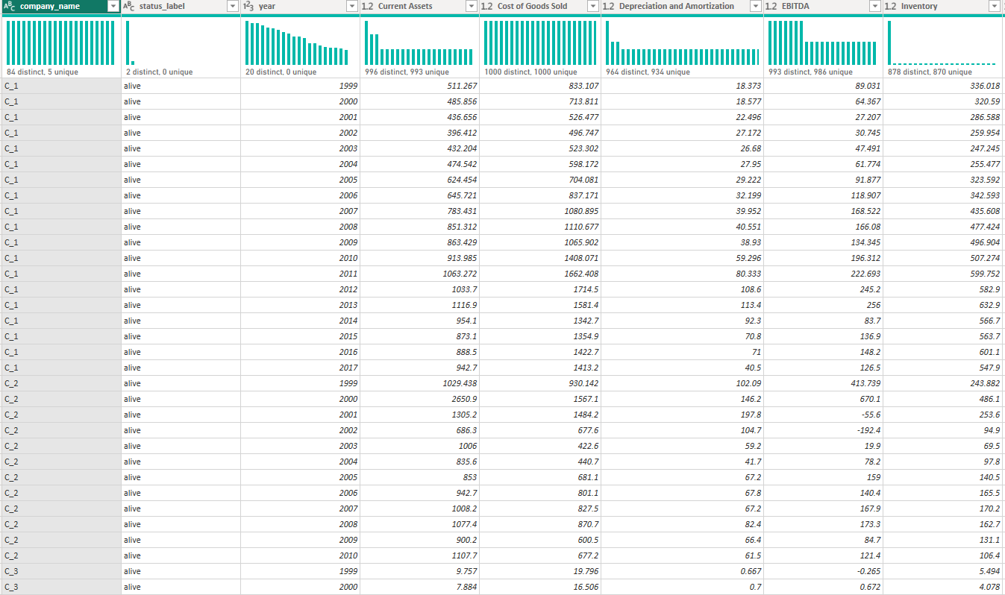
Initial Data Set: Bankruptcy Data
Notes:
The first data set that I began working with came from Kaggle and explored Bankruptcy data. The primary columns of focus were the status_label and the financial data presented. My initial goal was to attempt some form of predictive analytics using this class variable for the status, which assigned either Alive or Failed to a company in the list. The issue I quickly came across with this data set is that the units were not clear, it lacked a broad base of different variable types, limiting my analysis, and it just wasn’t going to get me visualizations I was happy with.

Slide 5
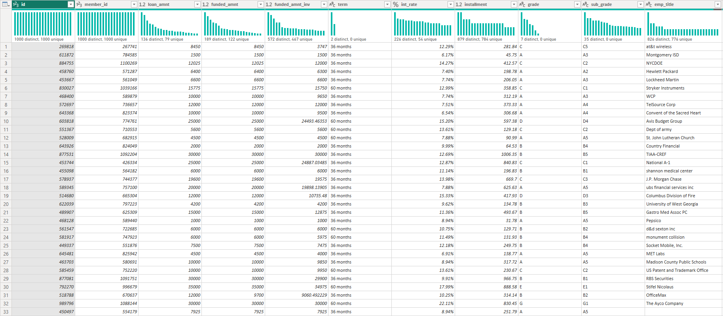
Switching Gears: Loan Data
Notes:
After realizing that the bankruptcy data wasn’t going to be able to produce the results I wanted, I shifted gears and found a new data set on Kaggle about loan data. This data set had over 100 column attributes and a healthy 1,000+ rows of data. This data also had a better mix of variable types and would allow me to try some different visualizations that I wouldn’t be able to use with the other data set limiting my options.

Slide 6
Data Analytics Plan
02

Slide 7
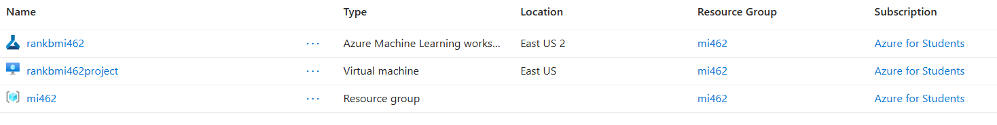
How I Planned to Analyze my Data
Azure Training
Azure SQL Database
Azure Fabric
Azure ML Studio
1
2
I began by first exploring some fundamental training plans in Azure, focusing on PowerBI and Office 365
I first tried jumping into a SQL Database within Azure, but found it was not possible with our subscription type
3
4
My next step was to jump into Fabric, however, after loading my data in, I was unable to get any workflows started, and also realized it wouldn’t be the best solution for my data sets
Azure’s ML Studio seemed like the best place for my initial bankruptcy data, but like Fabric, I was unable to get anything going that would meaningfully allow me to analyze my data
Notes:
The reason I chose to do predominately Office 365 and Power BI training was that in the Audit field, we are not so much doing data analytics with these cloud services, but more specific reporting and analytics on pre-made solutions. As such, I wanted to get as much mastery as possible in those areas before I begin work so that I have a leg up on other associates.
When I attempted the SQL database, I was hit with a hefty pay-wall, resulting in that solution being out of reach.
Fabric and ML studio would have been good solutions overall, but they were very complicated and not user friendly for the little training in them I had. ML Studio specifically was very confusing, as even after getting started and spinning up a VM, I was unsure how to really get into it with my data and explore the different analytics possible.
For the sake of this project, I decided to move on from these cloud solutions.

Slide 8
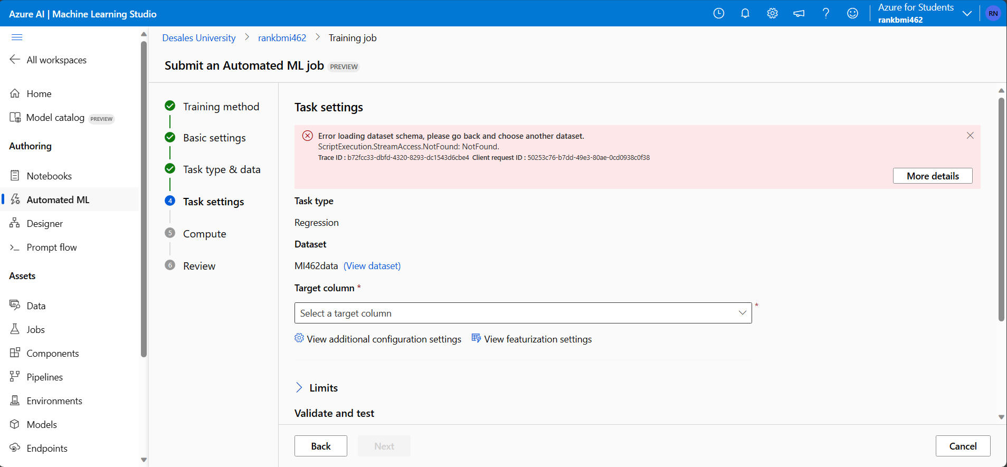
Trouble with ML Studio
Notes:
This is an example of one of the many issues I faced using Azure cloud services. Here, I was attempting to launch my first analytic through ML studio, and I was receiving an error. I tried many different times but was unable to find a solution.
This was really the last straw for me in using Azure, and why I decided to switch basis and head over to Power BI. Prior to switching to Power BI, I was very frustrated with the Azure platform and I think that stemmed from really having no clear direction on what services worked best for what process, and overall, just a lack of familiarity with cloud analytics and the limitations we faced. I found Power BI to be much easier to use as I had already done projects in that platform, and it’s ease of uploading and manipulating data is unmatched in Azure.

Slide 9
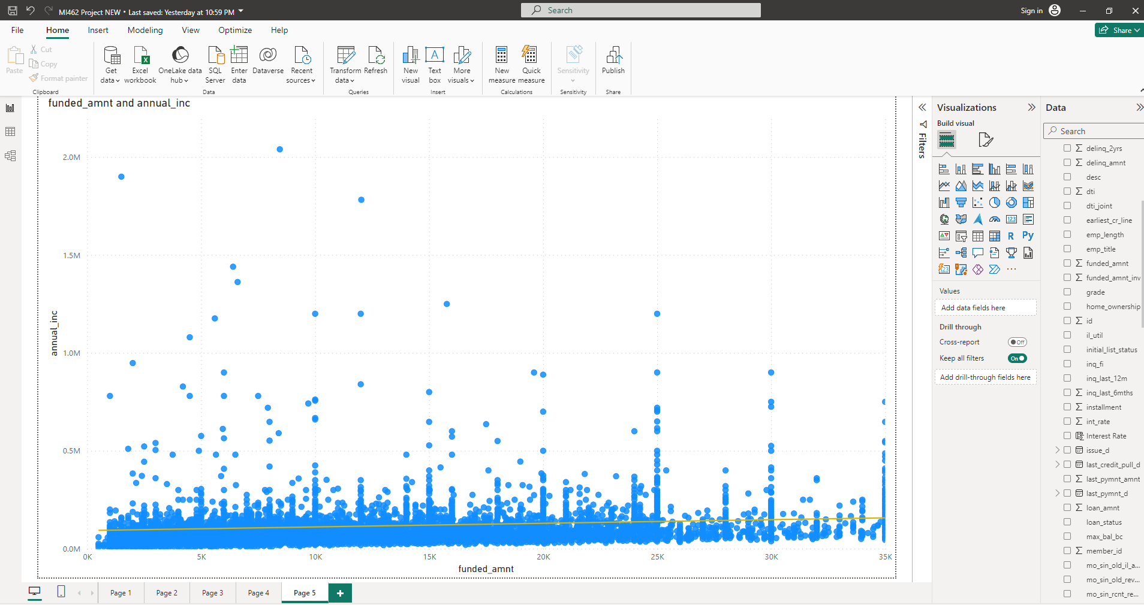
What I settled on: Power BI
Familiarity
I have experience and training with Power BI
Vast Number of Options
Power BI allows for the creation of a vast degree of different visualization types
Simplicity
Overall, Power BI provides a simple analytics and reporting platform

Slide 10
Data Visualizations
03

Slide 11
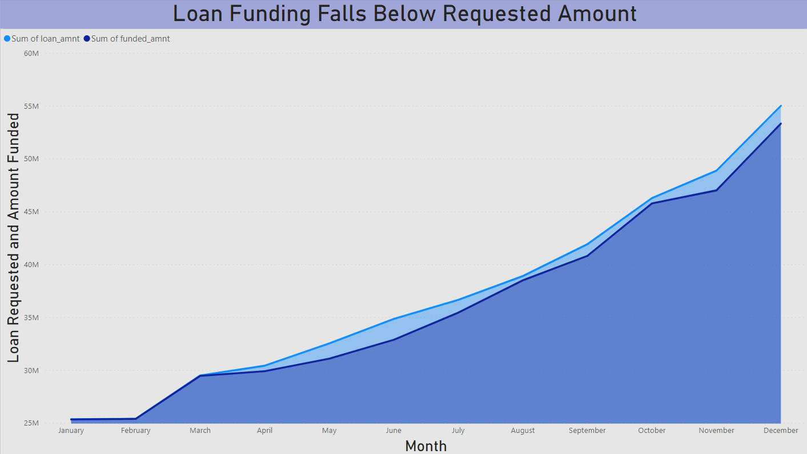
Notes:
This visualization actually gave me 2 different insights I was not expecting.
The first, is that at least for this dataset, which is comprised of 2023 data, amount of loans tends to increase throughout the year, with December being the highest month of loans requested and funded in $.
The other interesting thing is that we can se how the lighter blue line and area represents the loan amount requested by customers, with the darker blue region indicating the actual amount funded by the bank. As expected, the funded amount is slightly lower on average than the amount requested. This makes sense as some individuals may hold more risk for the bank in lending, and therefore, they will not meet the loan amount requested exactly. Spread across all the records in the dataset, this results in the sum having some significant differences around April-July, and again in October-December.

Slide 12
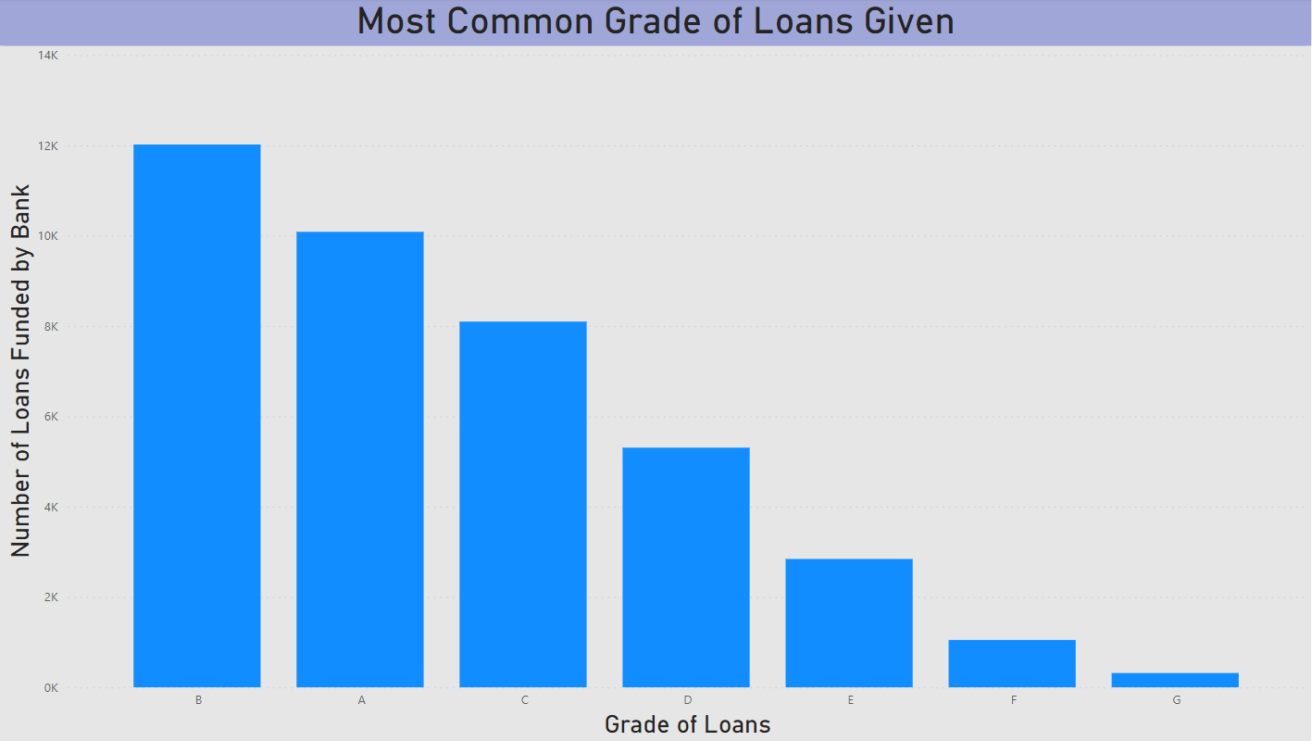
Notes:
Shifting gears, I found a variable in the data labeled grade. Upon examining the data, I noticed that it seemed as if this variable was rating the riskiness of the loans. For example, a Grade A loan would be a less risky and strong loan for the bank, and something like Grade F or G, a very risky loan.
What we see then is that the most common loans funded turn out to be either Grade B (the most common) or Grade A. This makes sense as banks and lending agencies do not want to take on extended amounts of risk in their portfolios.
At first I questioned why Grade A loans would not be most common, but it makes sense because the vast majority of the population is middle class. There will always be inherent risk in lending, but because the majority of the population is not in the high upper class, loans will be made more risky just due to the nature of socio-economic status. As a result, it seems that these middle grade loans, B, would be more popular than an A grade loan by nature.

Slide 13
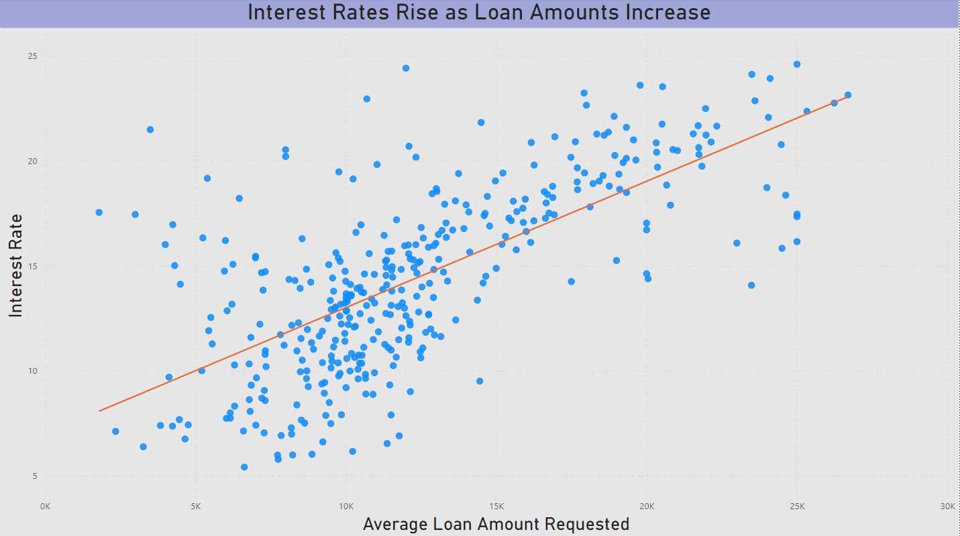
Notes:
An aspect of lending that I find particularly interesting as an Accounting and Finance major is the interest rates assigned to loans.
Here, I created a scatterplot to show the relationship between the interest rate, and the loan amount. On the whole, we see that as the loan amount increases, adding more risk to the loan, the interest rate, or compensation for the bank, increases. This relationship makes sense.
However, we also see an interesting insight occurring when we look at the tail ends of the plot. There are some loans which do not seem to follow the general trend, and these go to the heart of the lending practice and how we assign and calculate risk. For example, there are some loans that are very small, with an average under 5K, but they have interest rates rivaling loans of 3 or even 4 times the loan amount. Likewise, we see loans that have very high averages, but with moderately low interest rates for the amount lent.
This stems from our understanding that interest rates are derived from a variety of different factors and reasons, such as income, employment type, age, reason for the loan, credit history, etc. So while the loan amount is on one hand definitely positively related to interest rates, it is not the full picture for determining the rates assigned to a loan.

Slide 14
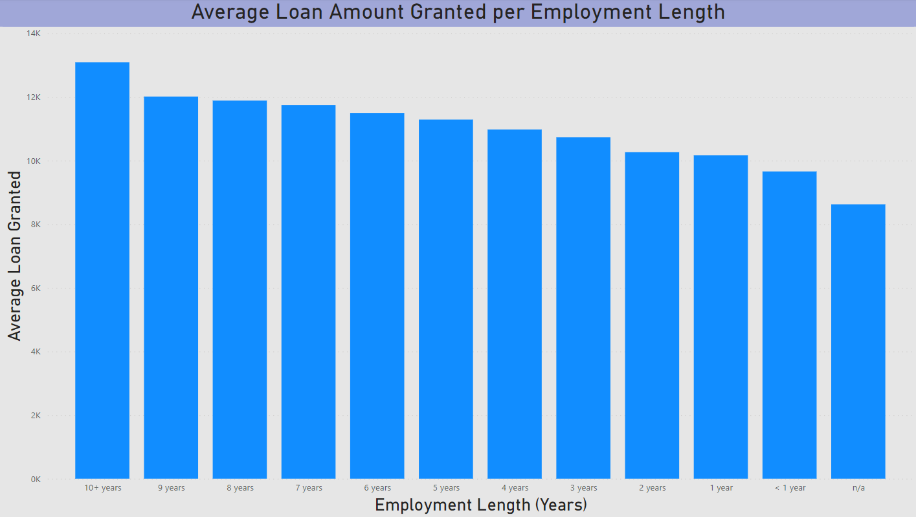
Notes:
The final visualization I created for this project looked at employment length by category, and the average loan granted. What we see is that the longer you are employed, the higher the average loan amount will be granted. This makes sense as longer employment history means that you have stable income and are more likely to have a lower level of defaulting on your loan. While not guaranteed, this is the general idea behind this.
What I find very interesting is that overall, the difference between the average loan amounts granted up to 10+ years are relatively similar, only increasing by 1-2k total over the time span. This could be due to either the customers requesting loans just having a higher average employment length, or, it could be that the lenders prefer customers with employment lengths and find them to have lower risk. This is definitely an internal policy that we obviously do not have the best insights into, but definitely an interesting relationship to explore.

Slide 15
Future Thoughts and Conclusion
04

Slide 16
Considerations for Future Analysis
Here are some of the ideas I have for diving into this dataset or topic area further:
Multiple Regression Analysis | Exploring the complex relationships that help drive interest rate determination
Filled Map Analysis of Loans | Analyze the locations of loans spread out across the 50 states
Predictive Analytics | Given a dataset, predicting loan interest rates given inputs for income, employment, etc.
Alterative Visualizations | Playing around with other visualization types to analyze the same data
Vastness of Data | Obtaining data that goes back beyond the beginning of 2023, expanding the analysis
New Tools | Utilizing additional analytics platforms like Tableau to further the analysis in new ways
Notes:
While I am happy with the visualizations and insights I explored from my data given that I was not able to get any of the Azure services to work for me, I do have some hopes for the future that I just wasn’t able to accomplish with this project.
First, I would like to look more intimately at the relationships between numerical variables and interest rates, hopefully enabling me to create a predictive model that can be fed new loan information and output a recommended interest rate for that loan.
I would also like to explore using filled maps to showcase the loans over the US. The issue I ran into when trying to do so with this project, is that the data was not allowing me to sort it into ranges easily within Power BI. This part comes hand in hand with my desire to explore other tools, like Tableau. In Tableau, I believe visualizations like maps are more sophisticated and easy to use, so I would like to try exploring other options like this in the future to add some depth to the analysis and further explore the loan data itself.
Finally, I think it is important to obtain a broader dataset. Although this dataset was adequately large for this project’s purpose, I think it would be really interesting to explore the data ranging back into the early 2000s, allowing some analysis throughout different periods like the Financial Crisis and Covid. This would provide some unique looks into how loans perform during poor economic conditions compared to normal times.

Slide 17


Concluding Thoughts
Power of Azure is immense, but very complicated to use
Power BI provides ease of use, but is limited in some analysis capabilities
Vast opportunities for future analysis and further insights
Loan data is very intricate and there are many insights to be found
Numerous relationships between interest rates and other applicant information
Risk greatly impacts loans and lenders willingness to lend to people

Slide 18
Thank You! Any Questions or Comments?

Slide 19
Data Source: Kaggle – Bank Loan Dataset
https://www.kaggle.com/datasets/puneetpainuly/bank-loan-dataset

